Slide 1




Natural
Language
Processing
Task
By : Karen Sameh

Slide 2


Introduction
Dataset Description
Dataset :
Source :
330K Arabic Sentiment Reviews
Kaggle Dataset
What is Sentiment Analysis?
Data Composition:
Text reviews in Arabic.
Labels: Binary classification (0 = Negative, 1 = Positive).
Process of determining the sentiment (positive/negative) in text.
Commonly used in social media analysis, customer feedback, and opinion mining.
Preprocessing Steps:
Removal of diacritics, punctuation, and special characters.
Normalization of Arabic letters.
Removal of stopwords.
Why Arabic Sentiment Analysis?
Arabic language has complex morphology and dialects.
Limited labeled datasets compared to English.

Slide 3
Data Splitting
BERT for Feature Extraction
70 % for Training , 15 % for Validation ,
15% for Testing
Tokenizer & Model Loading::
The code downloads and initializes a pre-trained Arabic BERT model and its corresponding tokenizer.
BERT Model Used:
aubmindlab/bert-base arabertv02 Arabic
Tokenizer and Model
Preprocessing Texts:
The function get_bert_embeddings converts raw texts into tokenized input, pads and truncates them to a fixed length, and transforms them into PyTorch tensors.
Why Use BERT?
Pretrained transformer model for contextual embeddings.
Captures meaning in sentences effectively.
Model Inference:
It then runs these tensors through the model in inference mode (no gradient computation) to obtain the hidden states.
Extracting the CLS Embedding:
Finally, it extracts the embedding corresponding to the [CLS] token for each input text, which can be used as a representative feature vector for that text..

Slide 4

Models Used for
Classification :
Bi-Directional RNN:
RNN Classifier
A bidirectional RNN.Processes sequences in both forward and backward directions.
Concatenates the hidden states from both directions.
Uses a simple recurrent cell.
Processes sequence information step-by-step
Vanishing gradients.
Bi-Directional LSTM:
A bidirectional LSTM.Captures context from both past and future with gating mechanisms.
Merges forward and backward hidden states for improved performance.
LSTM Classifier
Employs Long Short-Term Memory cells.
Uses gates (input, forget, output) to better capture long-term dependencies.

Slide 5
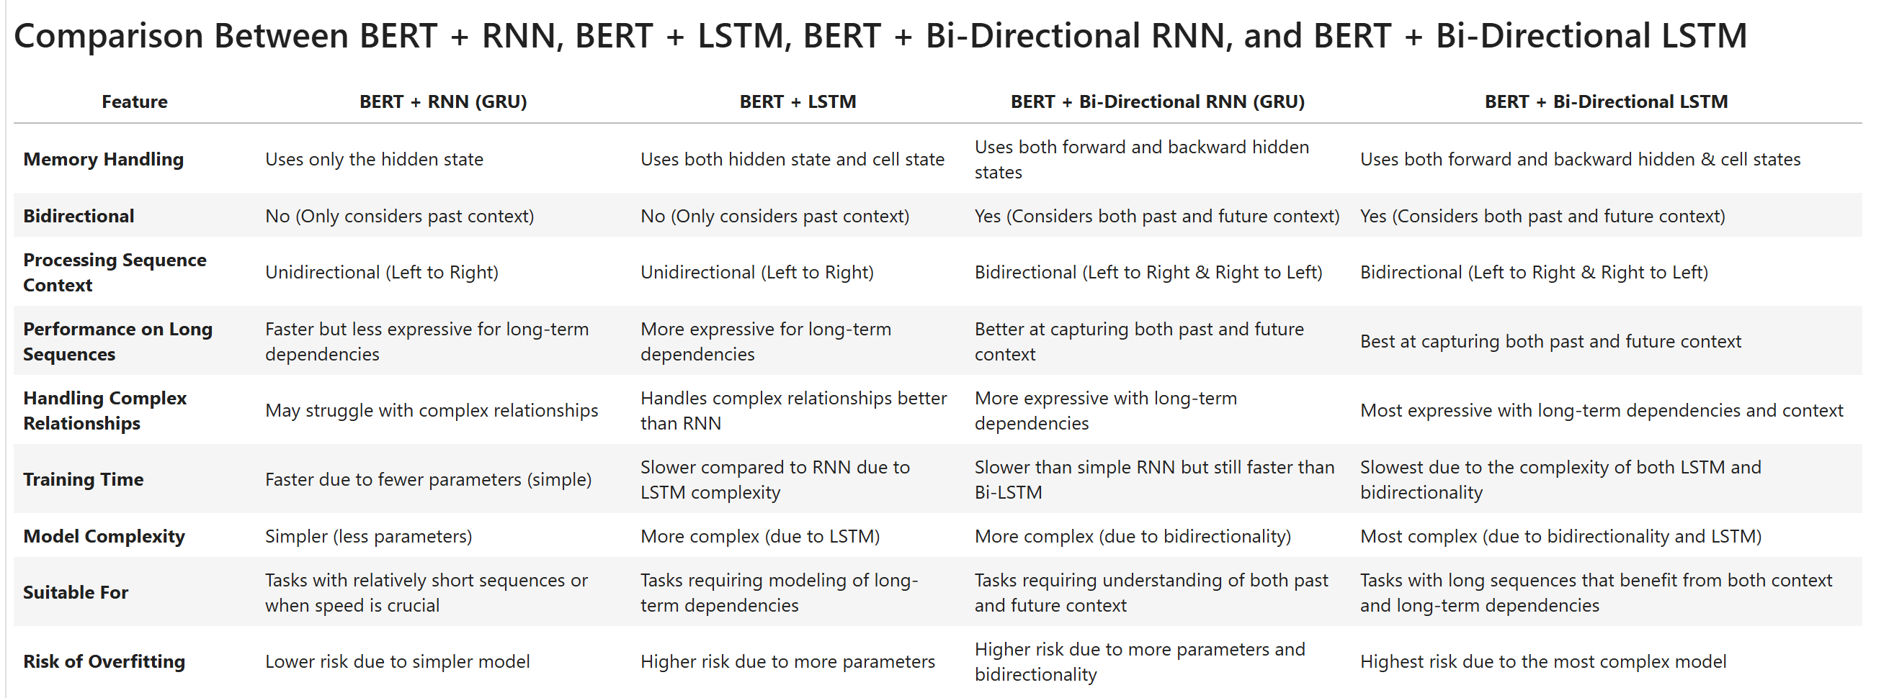
Models Used for
Classification :
RNN Classifier

Slide 6

Process
Training
Loss Function:
Binary Cross-Entropy
Optimization:
Adam Optimizer
Early Stopping Mechanism:
Monitors validation loss.
Stops training when improvement stagnates.
Learning rate scheduler (ReduceOnPlateau):
used the ReduceLROnPlateau scheduler to adjust the learning rate dynamically.
When validation loss stopped improving, the learning rate was reduced

Slide 7

Training and Evaluation
Results
RNN:
LSTM:
Converged after 41 epochs
Test Accuracy ≈ 89.41%
Converged faster (≈22 epochs)
Test Accuracy ≈ 89.61%
Bi-RNN:
Bi-LSTM:
Slightly improved context capture using bidirectionalityTest Accuracy ≈ 89.47%
Best performance with bidirectional LSTM layersTest Accuracy ≈ 89.73%
"All models achieved high validation and test accuracies (around 89%). The Bi-LSTM model, which leverages both forward and backward contexts with LSTM's gating mechanisms, reached the highest test accuracy. This suggests that for our dataset, incorporating bidirectional context with robust gating can offer a small but valuable performance boost."

Slide 8

Questions?
I'd be happy to discuss further!

